Slide 1
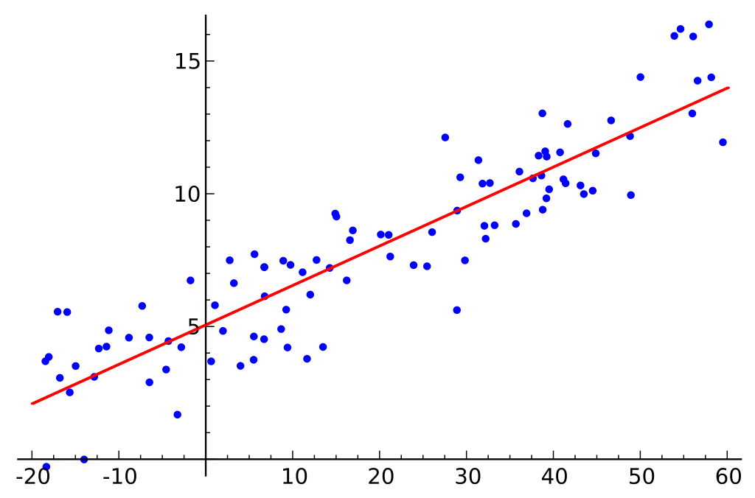
CRSS (PBGG) 8010:
Research Methods and Design in Crop Science
Jason Wallace Fall 2026
Lecture 14
Linear Regression I

Slide 2
Lecture outline
Administrative Stuff
Review of last time
Linear Regression principles
Linear Regression in practice

Slide 3
Administrative Stuff
Midterm 1 response due Thursday
  (Visibility issue fixed)

Slide 4
Review:
Quality Control
Download the dataset “14_muscadines.csv,” which is a RCBD of 6 muscadine varieties.
  Run basic quality control on both the raw data and after fitting an ANOVA model.
    “After” = using residuals() to extract the model residuals and test them
  Are there any odd datapoints or patterns you should be aware of?
If you find odd datapoints, remove them and rerun the ANOVA without them. What does it do to your data?

Slide 5
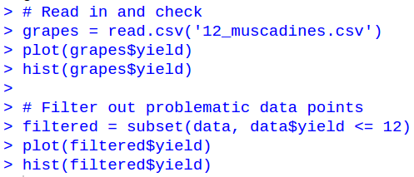
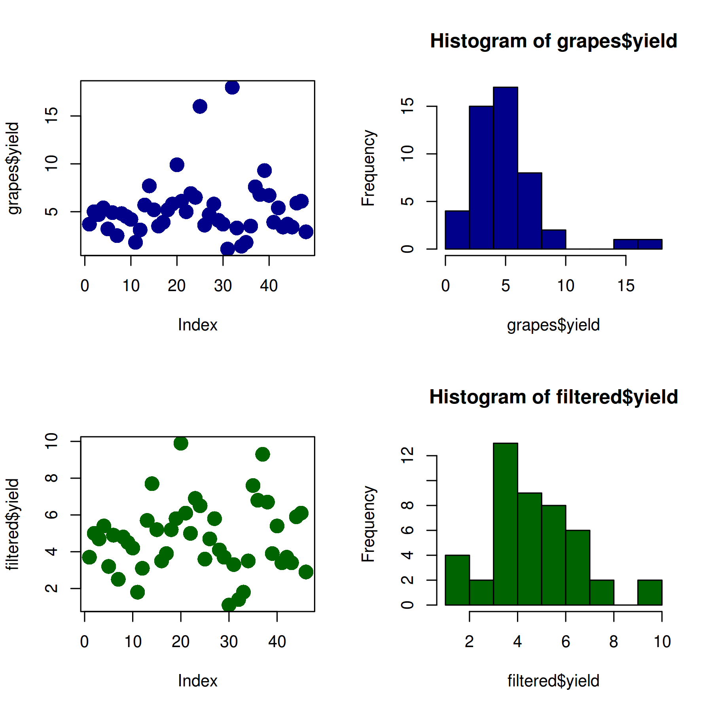
Review:
Quality Control
Raw Data
Note: I added additional parameters to make the plots more visible

Slide 6
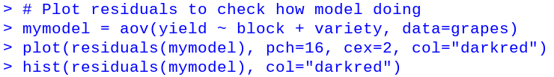
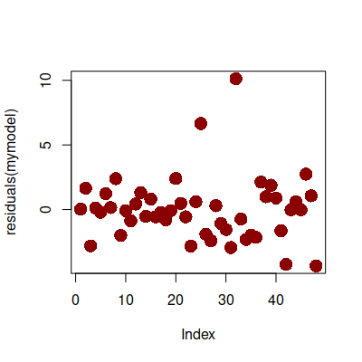
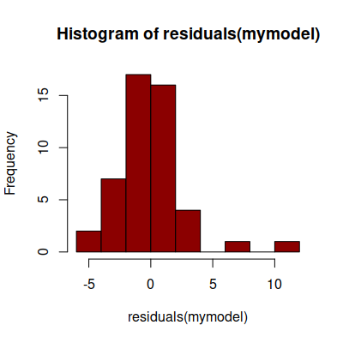
Review:
Quality Control
Residuals

Slide 7
Review:
Quality Control
Filtered
data

Slide 8
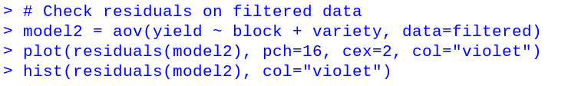
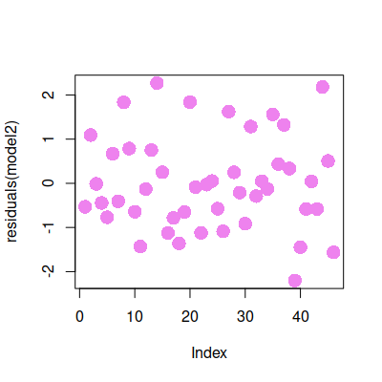
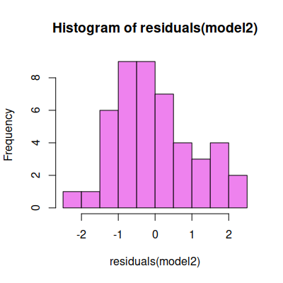
Review:
Quality Control
Residuals

Slide 9
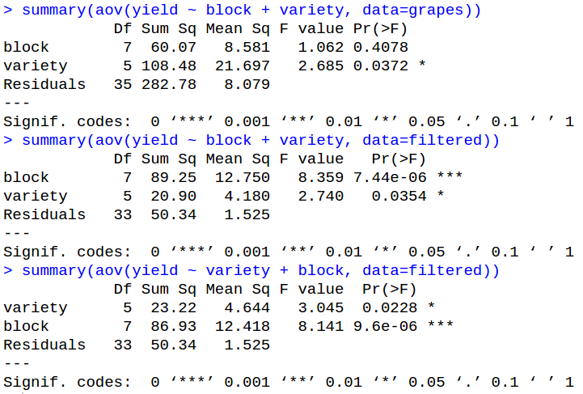
Review:
Quality Control
Raw data
Note: Your p-values may be slightly different if you fit variety before block
Filtered
Notes:
If you have unbalanced data, the order you put terms into the model will change what their p-values are. We’ll talk about this more later this lecture.

Slide 10
Review:
Interactions
Download the dataset “14_organic.csv”, which is test of different compost and biochar amendments and their effect on organic matter at the end of the season.
  Determine which factor(s) are significant, including the relevant interactions
  Plot the interaction plot

Slide 11
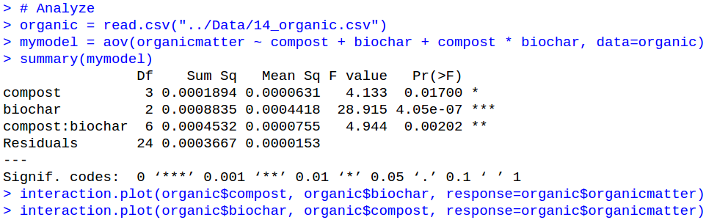
Review:
Interactions
Everything significant

Slide 12
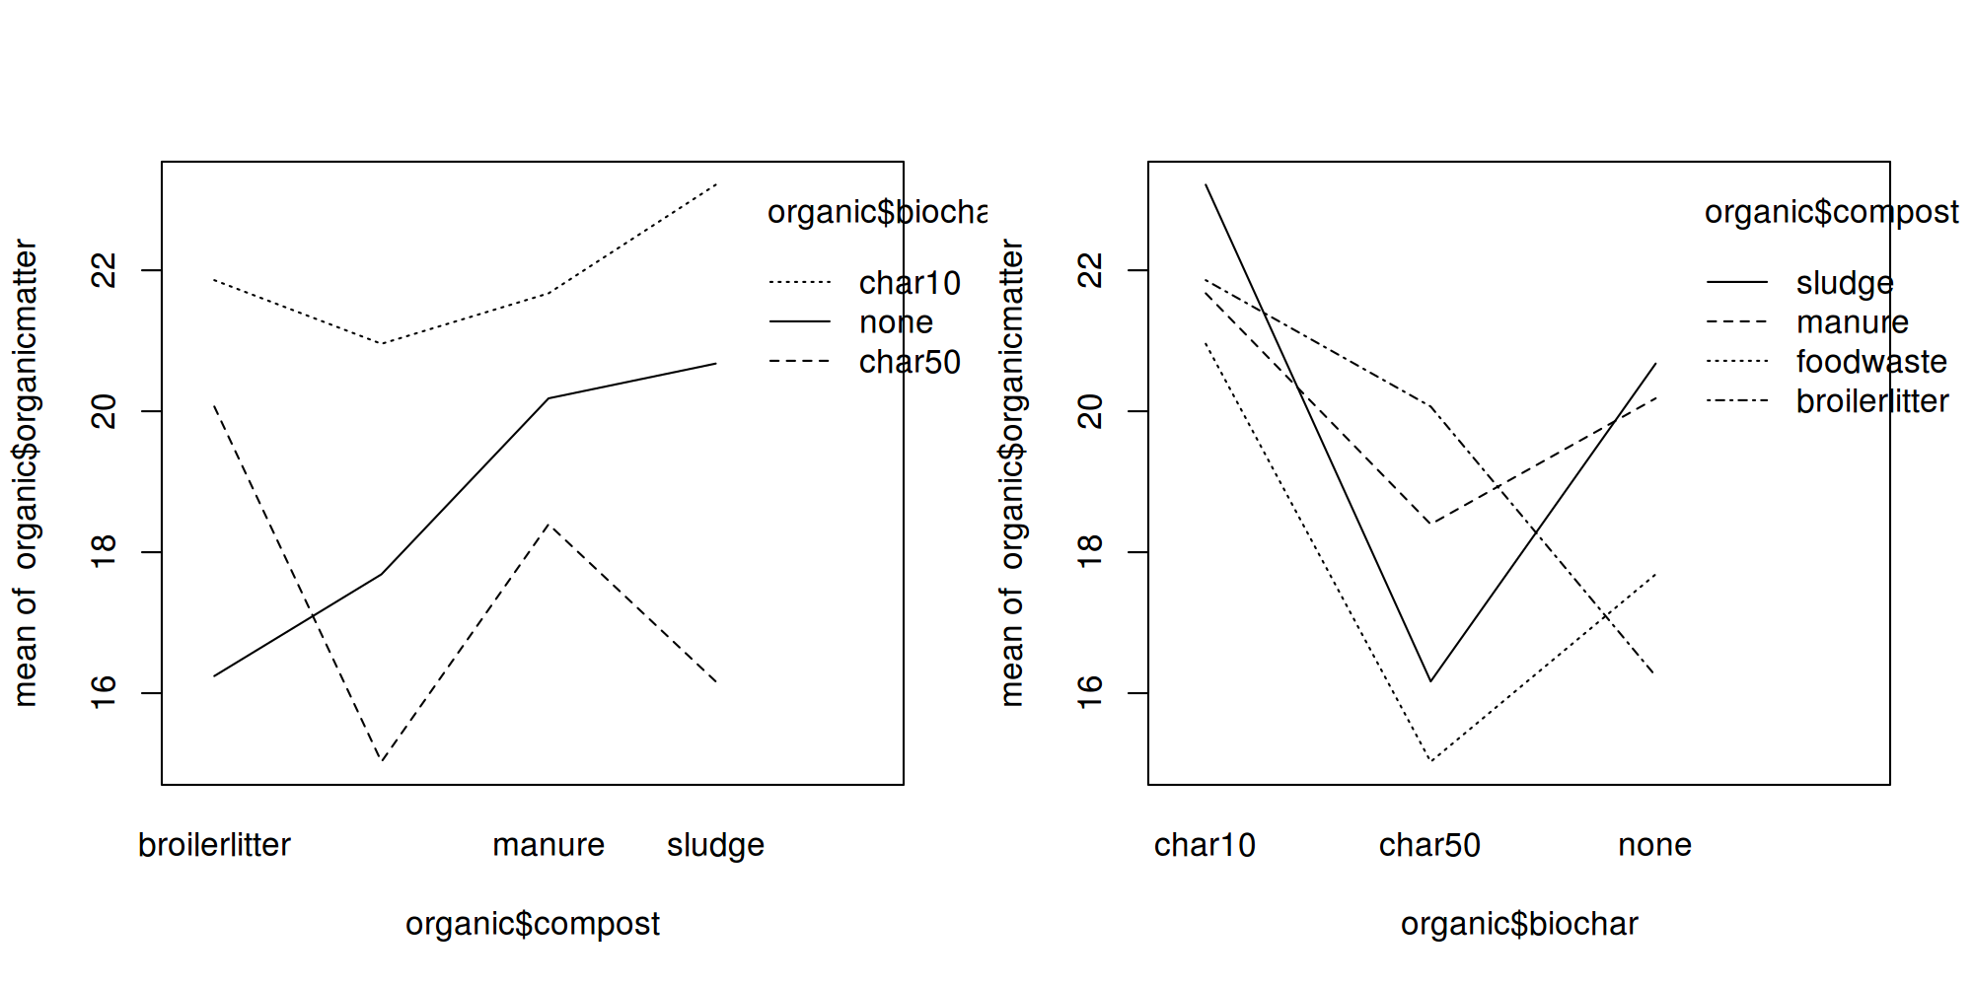
Review:
Interactions

Slide 13
Questions on last time’s materials?

Slide 14
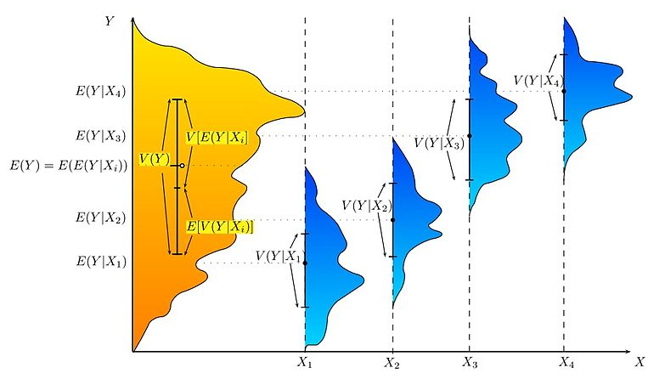
ANOVA reminder
Break apart by treatment
Up to now, we’ve been focusing on ANOVA to determine what is significant.
Among-treatment variance
Within-treatment variance

Slide 15
Shortcomings of ANOVA
ANOVA works well for
  Simple designs
  Balanced, categorical data
Complex designs and missing data, however, can make ANOVA very difficult
 | Variety 1 | Variety 2 | Variety 3 | Variety 4 | Variety 5
Rep1 Rep2 Rep3 | 296.6 267.3 292.6 | 330.9 348.8 345.4 | 302.6 271.0 288.8 | 304.6 320.3 294.8 | 280.8 271.3 276.3

Slide 16
Shortcomings of ANOVA
ANOVA works well for
  Simple designs
  Balanced, categorical data
Complex designs and missing data, however, can make ANOVA very difficult
 | Variety 1 | Variety 2 | Variety 3 | Variety 4 | Variety 5
Rep1 Rep2 Rep3 | 296.6 267.3 292.6 | 330.9 NA 345.4 | 302.6 271.0 288.8 | NA 320.3 294.8 | 280.8 271.3 276.3

Slide 17
On to Linear Regression
Linear regression is another way of getting to the same answers as ANOVA
ANOVA
Divide data into groups and see which groups explain the variation
Linear Regression
Estimate the effect of treatments and test if they differ from 0.
The goal of both ANOVA and Linear Regression is to minimize residual variation (=error)

Slide 18
Linear Regression versus ANOVA
ANOVA | Linear Regression
Categorical variables | Continuous & categorical variables
Categorical
Red, Green, Blue, Black…
Red, Green, Blue, Black…
Variety1, Variety2…
Variety1, Variety2…
Continuous
-47, 61, 27.3, -9, 0…
1.27, 3.44, 1.29, 2.88…

Slide 19
Linear Regression versus ANOVA
ANOVA | Linear Regression
Categorical variables | Continuous & categorical variables
Simple designs | Pretty much any design
CRD, RCBD, Latin Square
CRD, RCBD, Latin Square
Split plot, Strip plot, Augmented…

Slide 20
Linear Regression versus ANOVA
ANOVA | Linear Regression
Categorical variables | Continuous & categorical variables
Simple designs | Pretty much any design
Fixed effects only | Fixed & Random Effects
(we’ll talk more about these later in the class)

Slide 21
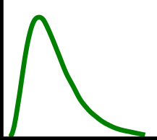
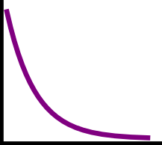
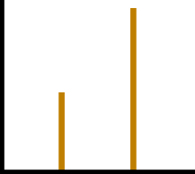
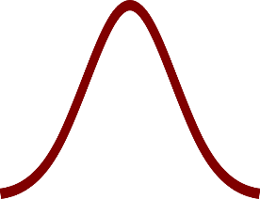
Linear Regression versus ANOVA
ANOVA | Linear Regression
Categorical variables | Continuous & categorical variables
Simple designs | Pretty much any design
Fixed effects only | Fixed & Random Effects
Requires normality | Can extend to non-normal datasets

Slide 22
Linear Regression versus ANOVA
In short, linear regression can do everything ANOVA can do, plus other stuff
  Many statisticians actually consider ANOVA to be a special case of regression
  The aov() function even uses regression under the hood, not true ANOVA
The focus on ANOVA for the analyses we’ve been doing is partly historical and partly because it’s more intuitive
  Going forward, our ability to use ANOVA will drop, so we will rely on regression almost exclusively.

Slide 23
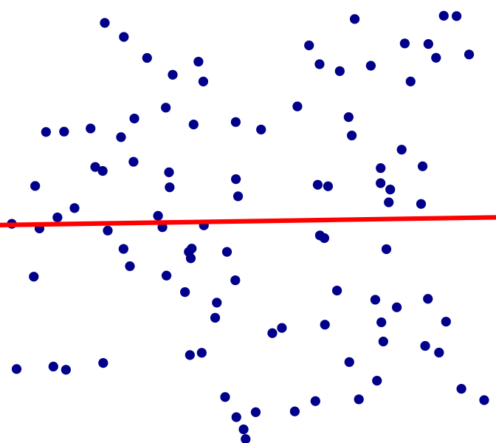
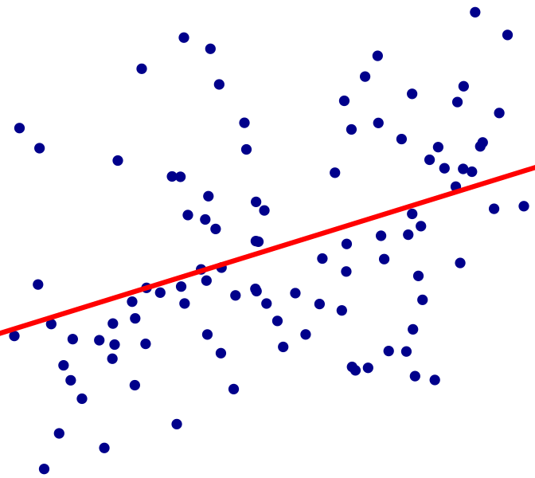
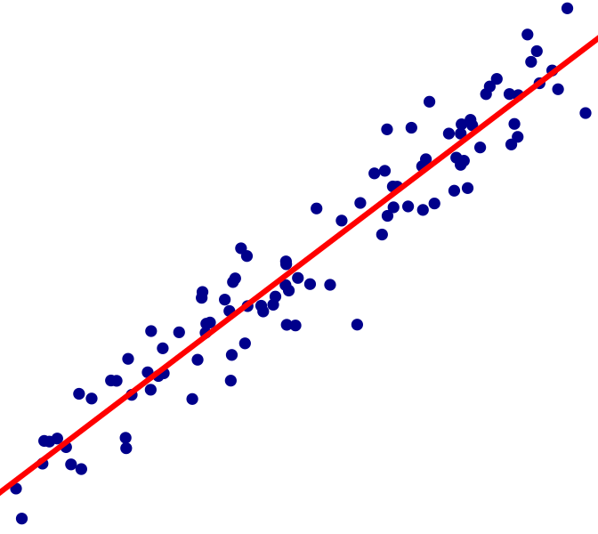
Linear Regression
The goal of linear regression is to take data and determine how well one or more variables can explain that data
Simple example: How well does X explain Y?
Poor
Okay
Good
Y
X1
X2
X3

Slide 24
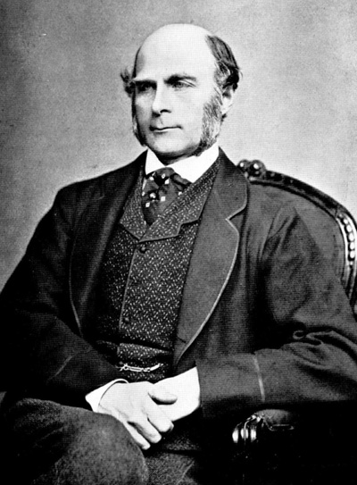
The origins of regression
Linear regression began with genetics
Sir Francis Galton
Notes:
This is a good time to mention that Galton was a brilliant scientist, but also a eugenicist and a racist. Basically, his insight into how to analyze genetics was amazing, but his choices in how to use it, not so much.

Slide 25
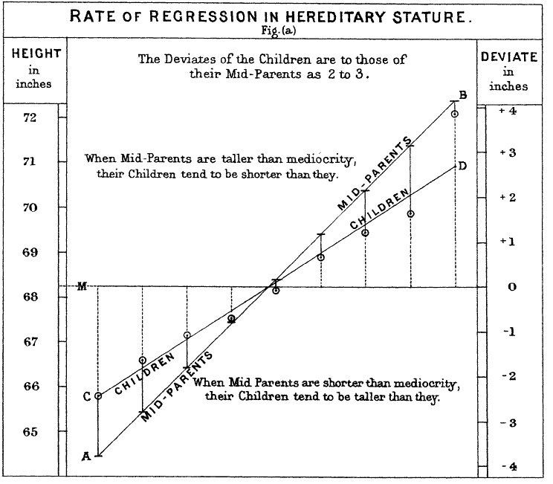
The origins of regression
Linear regression began with genetics
Galton’s observations:
  The children of tall parents are not as tall
  The children of short parents are not as short
Conclusion: Children tend to “regress” (move back) toward the mean value
Galton 1885, Regression Towards Mediocrity in Hereditary Stature

Slide 26
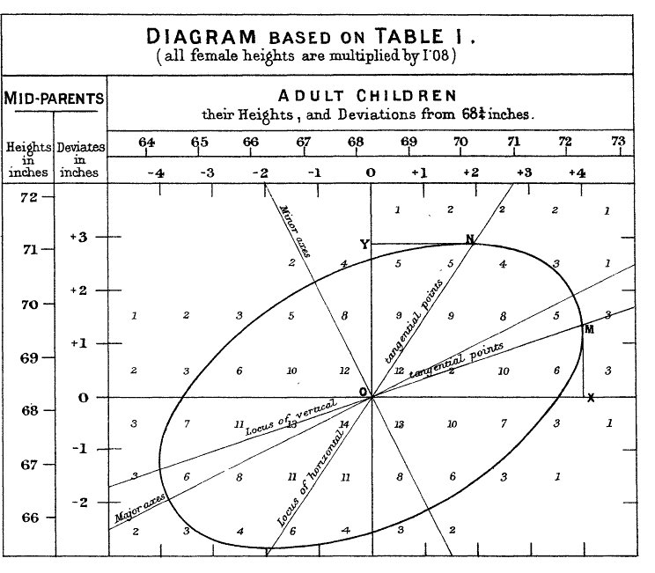
The origins of regression
Linear regression began with genetics
Galton’s observations:
  The children of tall parents are not as tall
  The children of short parents are not as short
Conclusion: Children tend to “regress” (move back) toward the mean value
“Regression” line
Galton 1885, Regression Towards Mediocrity in Hereditary Stature

Slide 27
Goal of linear regression
Find the line that best summarizes a lot of data with minimal error
Error

Slide 28
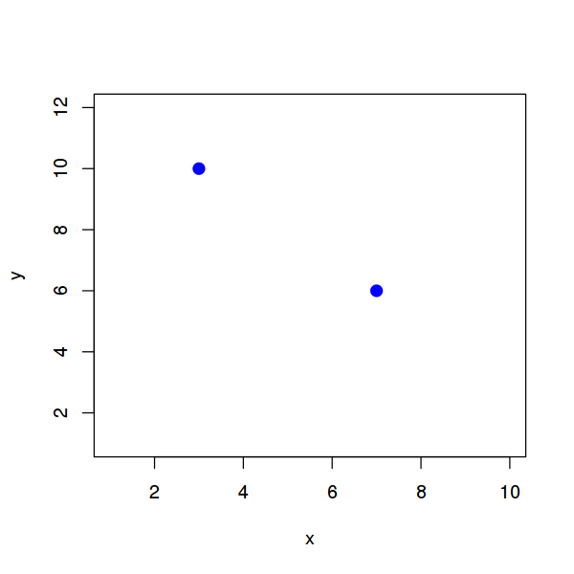
In-class exercise:
Optimal regression line
Find the regression line that best explains this data:
X | Y
3 | 10
7 | 6
  Need two parameters: slope and intercept
Y = ___X + ___
Sum of squared error: ____

Slide 29
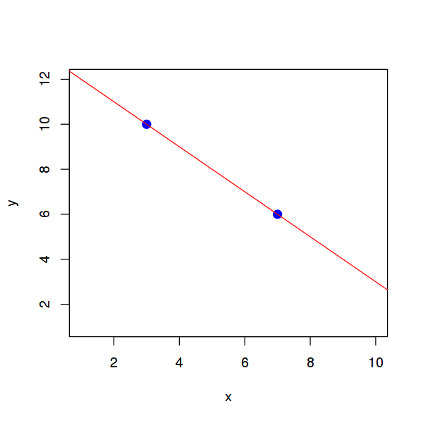
In-class exercise:
Optimal regression line
Find the regression line that best explains this data:
X | Y
3 | 10
7 | 6
  Need two parameters: slope and intercept
Y = ___X + ___
-1
13
0
Sum of squared error: ____

Slide 30
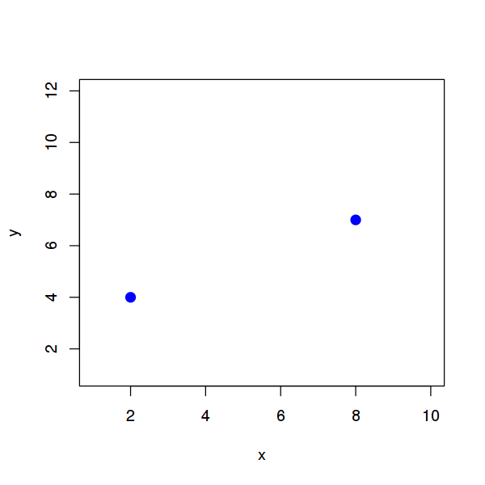
In-class exercise:
Optimal regression line
Find the regression line that best explains this data:
X | Y
2 | 4
8 | 7
  Need two parameters: slope and intercept
Y = ___X + ___
Sum of squared error: ____

Slide 31
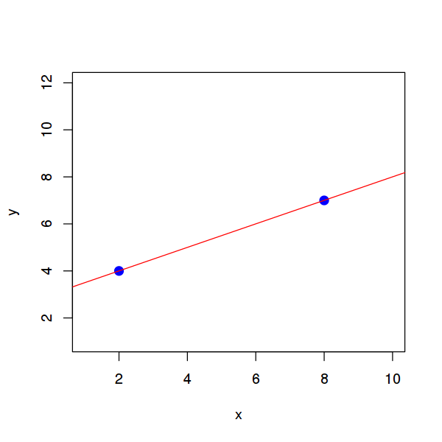
In-class exercise:
Optimal regression line
Find the regression line that best explains this data:
X | Y
2 | 4
8 | 7
  Need two parameters: slope and intercept
Y = ___X + ___
0.5
3
0
Sum of squared error: ____

Slide 32
In-class exercise:
Optimal regression line
Find the regression line that best explains this data:
X | Y
2 | 4
8 | 7
  Need two parameters: slope and intercept
Y = ___X + ___
Sum of squared error: ____

Slide 33
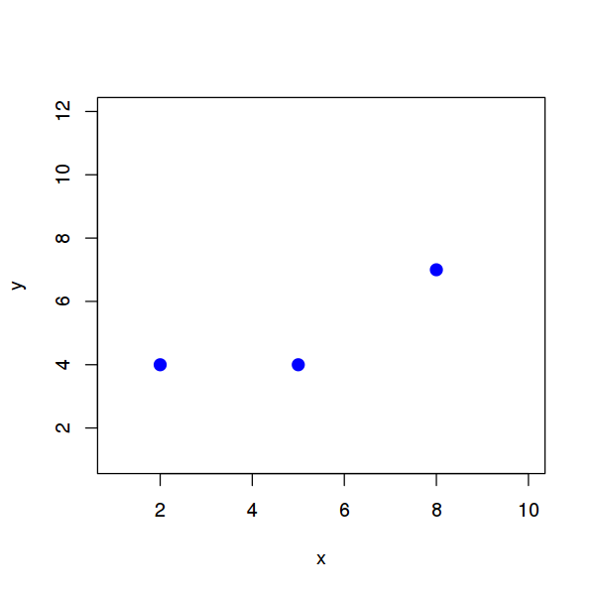
In-class exercise:
Optimal regression line
Find the regression line that best explains this data:
X | Y
2 | 4
5 | 4
8 | 7
  Need two parameters: slope and intercept
Y = ___X + ___
Sum of squared error: ____

Slide 34
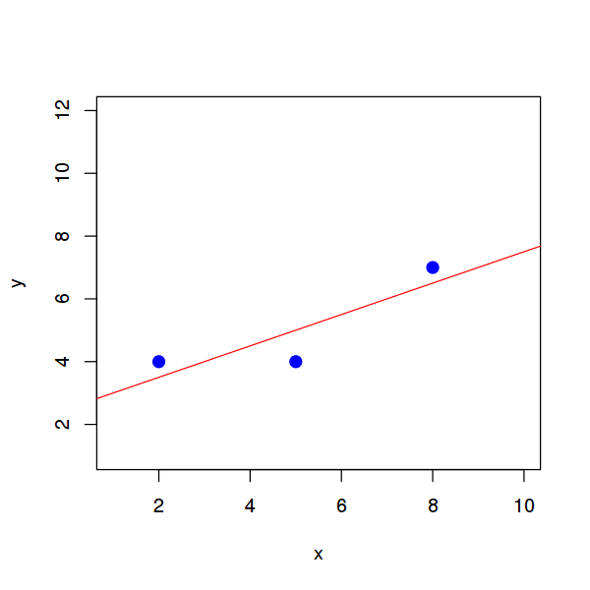
In-class exercise:
Optimal regression line
Find the regression line that best explains this data:
X | Y
2 | 4
5 | 4
8 | 7
  Need two parameters: slope and intercept
Y = ___X + ___
0.5
2.5
1.5
Sum of squared error: ____
Notes:
Going to skip the explanation of how we got these numbers for now; that will be a little later. Right now the focus is on showing that these are, indeed, the optimum numbers.

Slide 35
In-class exercise:
Optimal regression line
Find the regression line that best explains this data:
X | Y
2 | 4
5 | 4
8 | 7
Y (predicted) | Error
  Need two parameters: slope and intercept
Y = ___X + ___
0.5
2.5
1.5
Sum of squared error: ____

Slide 36
In-class exercise:
Optimal regression line
Find the regression line that best explains this data:
X | Y
2 | 4
5 | 4
8 | 7
Y (predicted) | Error
3.5 | 0.5
5 | 1
6.5 | 0.5
  Need two parameters: slope and intercept
Square and sum to get
Y = ___X + ___
0.5
2.5
1.5
Sum of squared error: ____
Notes:
Whereas with ANOVA we look at differences from the mean value, in linear regression we look at differences from the predicted value. (Though if you think about it, the mean _is_ what we would predict based on what data we have, so these are really the same thing)

Slide 37
The Core of Linear Regression
All basic linear regressions can be represented by a single formula:
Y = Xβ + ε
Error
The leftovers we can’t explain
Dependent variable
The thing we want to explain
Regression coefficient(s)
How each part of X relates to Y
Independent variable(s)
The things we use to explain it

Slide 38
The Core of Linear Regression
All basic linear regressions can be represented by a single formula:
Y = Xβ + ε
You may notice that this is very similar to the classic formula for a line:
Slope
Intercept
y = mx + b
Dependent variable
Independent variable
Notes:
The resemblance here is partly coincidence and partly real. Multiplying X by numbers to get the line is the same idea in both cases, but the constants on the end (the error and the “b” slope) are coincidence. (The intercept is actually included as part of the Beta term in linear regression)

Slide 39
The Core of Linear Regression
This equation is actually in “matrix notation”
For this class, we’ll unpack it into a more familiar form:
Y = Xβ + ε
y = x₁β₁ + x₂β₂ + x₃β₃ …
With linear regression, our goals are to:
  Figure out what the βs are
    aka, “What are the coefficients?”
  Make the error as small as possible
Notes:
If you want to learn all the Matrix-y details, take my GWAS class next semester

Slide 40
Questions on linear regression so far?

Slide 41
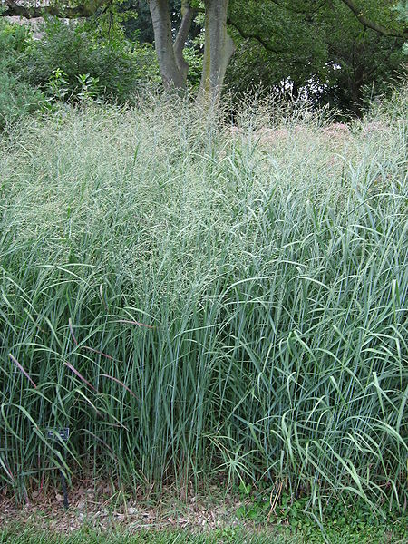
Linear regression example
Example experiment: Switchgrass biomass production
A (very) tiny experiment testing how adding nitrogen fertilizer affects switchgrass growth:
Plot | Biomass | Nitrogen
001 | 17.6 | 10
002 | 14.3 | 5
003 | 18.9 | 10
004 | 12.6 | 5

Slide 42
Linear regression example
Dependent
Plot | Biomass | Nitrogen
001 | 17.6 | 10
002 | 14.3 | 5
003 | 18.9 | 10
004 | 12.6 | 5
So, let’s unpack this data:
  What is the dependent variable?
  What is/are the independent variable(s)?
Our assumption is that there is a linear
relationship between nitrogen applied
and biomass produced
  That is, y = βx + ε, not βx², βx³, or the like
  Quadratic, cubic, and other regression can be done, but usually isn’t.
Independent
Notes:
We assume that the amount of nitrogen supplied affects biomass produced, not vice-versa.
The dependent variable is usually easy to spot because it’s the thing you want to explain
In this case, the “plot” column is just a label, so we can ignore it for the regression.

Slide 43
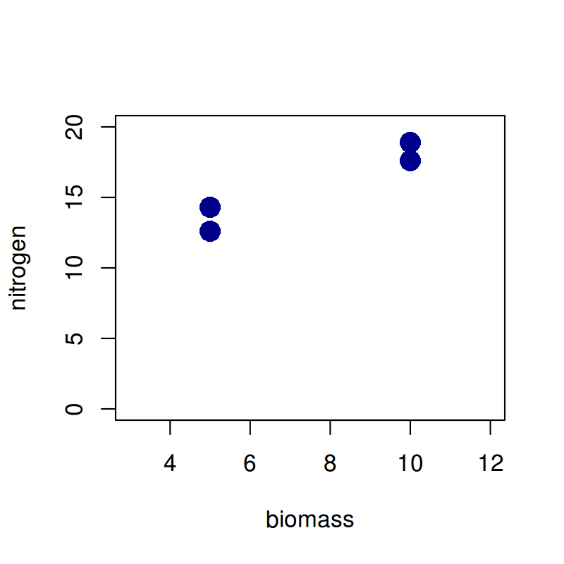
Linear regression example
Plot | Biomass | Nitrogen
001 | 17.6 | 10
002 | 14.3 | 5
003 | 18.9 | 10
004 | 12.6 | 5
So, how to find the line?

Slide 44
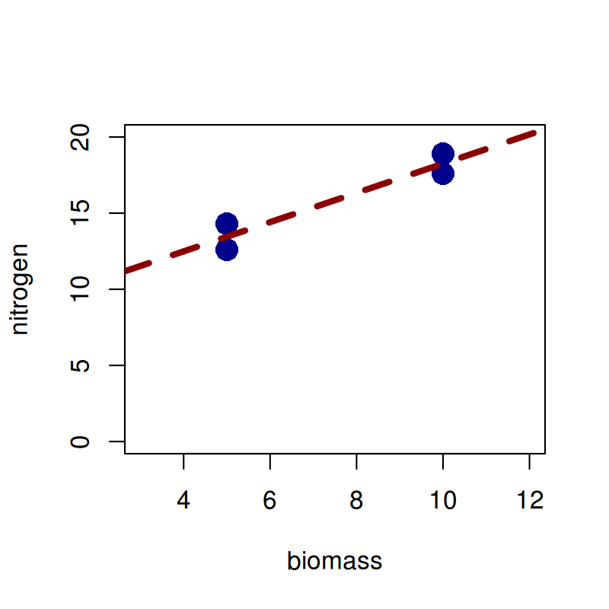
Finding the regression line
Finding the regression line involves using matrix algebra, which is outside the scope of this class
Plot | Biomass | Nitrogen
001 | 17.6 | 10
002 | 14.3 | 5
003 | 18.9 | 10
004 | 12.6 | 5
Matrix Algebra!
b = 0.96*n + 8.65

Slide 45

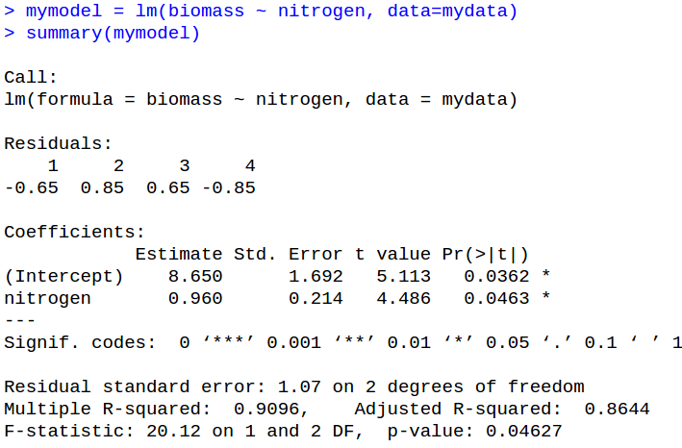
Linear regression in R
Basic linear regression in R is done by the function lm():
Regression Equation
Call to lm()
Source of data
(if not given, looks for variables in the local environment)
Variable to capture result
Notes:
Basically, you call lm() just like you call aov()

Slide 46
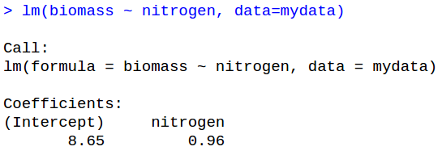
Interpreting R output
When running a linear regression, the output of the regression itself isn’t very informative
Function call
Coefficients

Slide 47
Interpreting R output
Just as with aov(), you get much better information by calling summary() on the model

Slide 48
Anatomy of the model summary
Function call
Residuals
Note: with lots of data, you get quantiles instead
Coefficient information
Model information

Slide 49
Anatomy of the coefficient summary
Coefficient names
Estimated value (=β)
Significance codes
SE (β)
t score
p-value

Slide 50
Anatomy of the model summary
Estimated residual variance
Measures of model fit
Model significance values

Slide 51
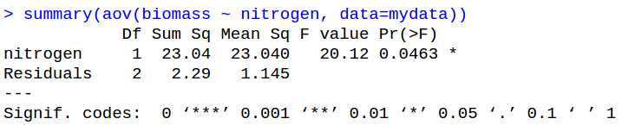
aov() versus lm()
Compare output of aov() and lm():
lm()
aov()
Identical p-values for Nitrogen

Slide 52
In-class exercise:
Linear regression in R
Download “14_yield.csv” from eLC
Load the data into R and run a linear regression, treating yield as a function of block, p, and n.
  Is the model significant overall?
  Which variable(s) are significantly associated with yield in this data?

Slide 53
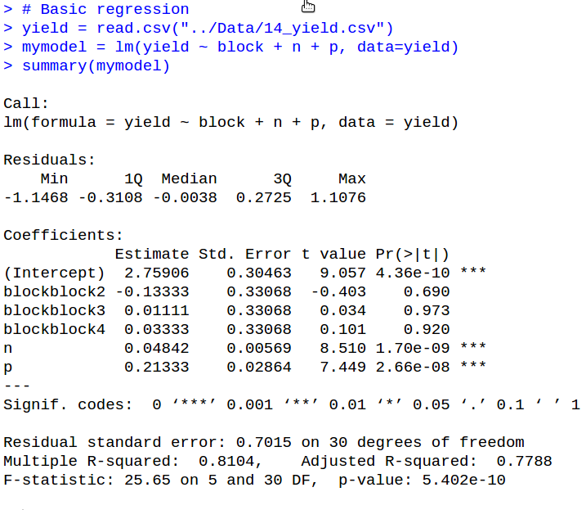
In-class exercise:
Linear regression in R
…
Intercept is almost always significant but can be ignored
Notice what happened to the factor; more on this later.
N & P are significant
Model is significant

Slide 54
Questions on linear regression in R?

Slide 55
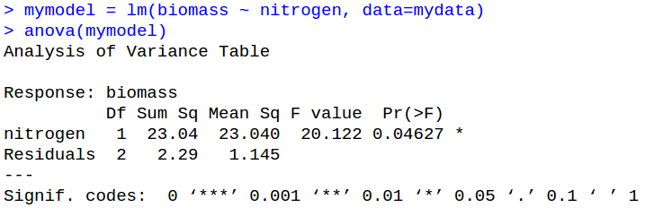
ANOVA with linear regression
Even though linear regression tells us what is significant, we sometimes still want to know about variation explained.
For this, we use anova() on the model output.

Slide 56
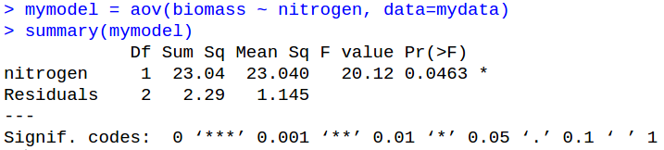
ANOVA with linear regression
Even though linear regression tells us what is significant, we sometimes still want to know about variation explained.
For this, we use anova() on the model output.
This output is basically identical to aov():

Slide 57
So why two methods?
To be honest, I don’t know why both aov() and anova() exist in R
  Probably someone just wanted it that way
In practice, aov() actually calls lm() under the hood, so the difference is minor
The important thing is that lm() is much more versatile, so we will be using it from here on
  I didn’t introduce it earlier because I already felt I was front-loading a lot of abstract statistics

Slide 58
Linear regression variables
In the practice, you saw that lm() splits factors apart:
This is because of how linear regression treats factors under the hood
  It’s also related to why factors use n-1 DOF
Factors
Continuous

Slide 59
Linear regression & factors
Technically, linear regression can only handle continuous variables
However, there’s an easy workaround by splitting one factor into a group of “indicator” variables

Slide 60
Linear regression & factors
Maturity group
early
early
early
middle
…
late
late
Early | Middle | Late
1 | 0 | 0
1 | 0 | 0
1 | 0 | 0
0 | 1 | 0
… | … | …
0 | 0 | 1
0 | 0 | 1
Linear regression deals with categories by making a set of “indicator variables” that can only take two values:
  1 means “is part of this category”
  0 means “is not part of this category”
Notes:
Coding variables like this is usually called “dummy coding” because the indicator variables are “dummy variables” for the real thing

Slide 61
Linear regression & factors
Maturity group
early
early
early
middle
…
late
late
Early | Middle | Late
1 | 0 | 0
1 | 0 | 0
1 | 0 | 0
0 | 1 | 0
… | … | …
0 | 0 | 1
0 | 0 | 1
DOF comes into play here: n categories can be specified with (n-1) variables
You can drop any category; R usually drops the first.
Notes:
Technically, you _have_ to drop one of the categories due to how the linear algebra works. If you don’t, the math won’t work out right.

Slide 62
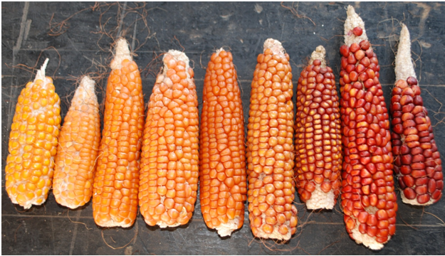
In-class exercise:
Indicator variables
Turn the following into a set of indicator variables:
Coloration
Red
Yellow
Orange
Yellow
Orange
Orange
Red

Slide 63
In-class exercise:
Indicator variables
Turn the following into a set of indicator variables:
Coloration
Red
Yellow
Orange
Yellow
Orange
Orange
Red
Red
1
0
0
0
0
0
1
Orange
0
0
1
0
1
1
0
Yellow
0
1
0
1
0
0
0

Slide 64


In-class exercise:
Indicator variables
Turn the following into a set of indicator variables:
Plant Sex
Male
Male
Female
Male
Female
Female
Female
CarolinaNature.com

Slide 65
In-class exercise:
Indicator variables
Turn the following into a set of indicator variables:
Plant Sex
Male
Male
Female
Male
Female
Female
Female
Male
1
1
0
1
0
0
0
Female
0
0
1
0
1
1
1
CarolinaNature.com

Slide 66
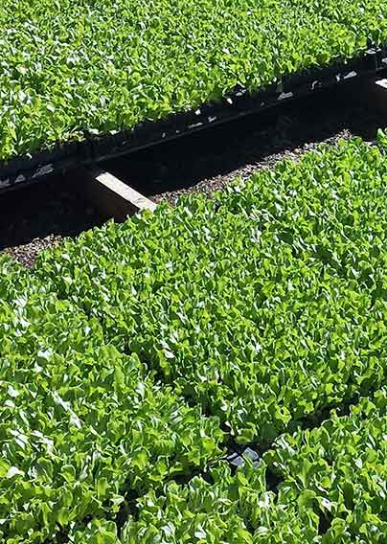
In-class exercise:
Indicator variables
Turn the following into a set of indicator variables:
Block
Block1
Block2
Block3
Block4
Block5
Block6
Block7
PlantTape.com

Slide 67
In-class exercise:
Indicator variables
Turn the following into a set of indicator variables:
Block
Block1
Block2
Block3
Block4
Block5
Block6
Block7
B1
1
0
0
0
0
0
0
B2
0
1
0
0
0
0
0
B3
0
0
1
0
0
0
0
B4
0
0
0
1
0
0
0
B5
0
0
0
0
1
0
0
B6
0
0
0
0
0
1
0
B7
0
0
0
0
0
0
1
PlantTape.com

Slide 68
Questions on indicator variables?

